Slide 1


Slide 2

Introduction
When you're searching for childcare, you want the best for your child and family. You want a warm, safe and secure environment where your child can play and grow.
Our homely environment provides an easy transition to make leaving your children that little bit easier.
We provide opportunities and challenges for children, allowing them to explore and develop at their own pace, in their own way.
It is a real passion and a great responsibility working with children to give them the best start in life. All our staff have a wealth of knowledge and love what they do!

Slide 3

Where it all started….
Rachael’s Rascals Childcare started in 2013. The company was founded by Rachael who has worked in childcare for 13 years. After working in various settings and gaining lots of experience Rachael took her passion for childcare and started her own business, working from home. 6 years later and Rachael has opened her own nursery with the home from home care still being the focus.
Rachael has child minded from home and in that time built up a good understanding of what parents look for when deciding on childcare options.
“parents want to feel confident that they are leaving their children in the safest hands and that their child will be looked after and cared for to the highest standards”
Rachael Weldon

Slide 4
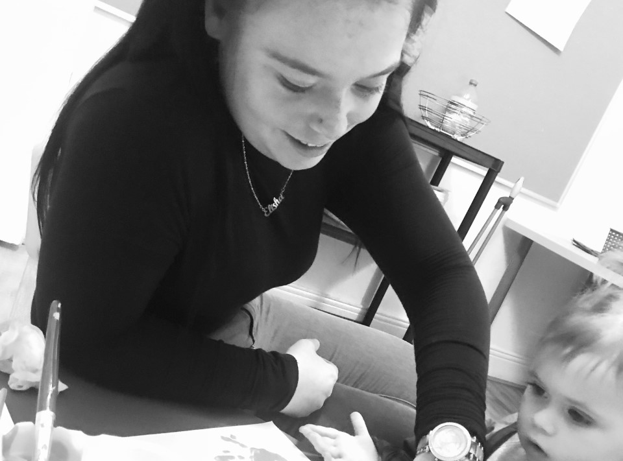
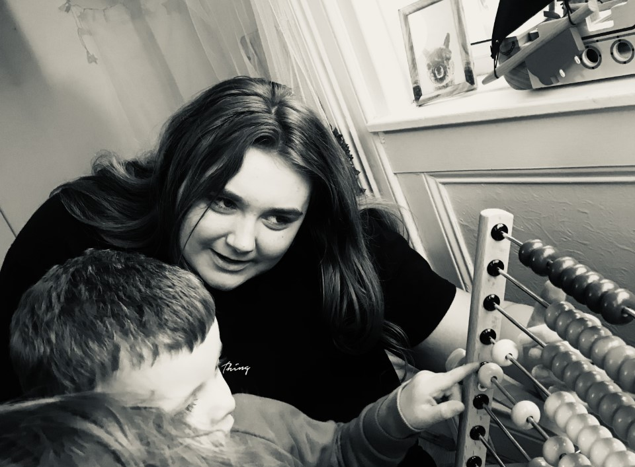
Key person
Children thrive when they get to grow close relationships with people who care about them. At nursery, your child will be around other children and have their own key person.
While our whole team will care for your child at nursery, their key person is the one who really gets to know them and you. Your child’s key person is someone you can talk to about your child, family life and will update you on your child’s development and how their day has been.
Staff Ratios
At nursery we make sure your child Is safe and secure while they explore and investigate. To do so we make sure we have the correct adult to child ratios.
Babies under 2- 1 staff member for every 3 children
Children aged 2 to 3 years- 1 staff for every 4 children
Pre-school- 1 staff member for every 8 children

Slide 5
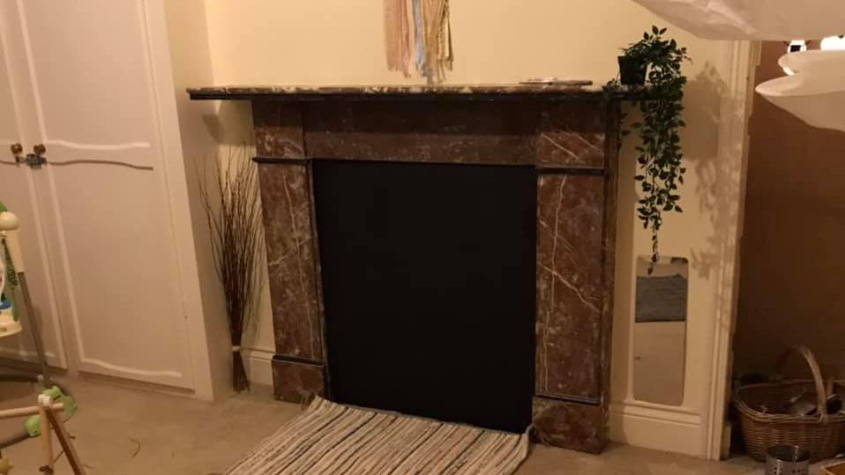
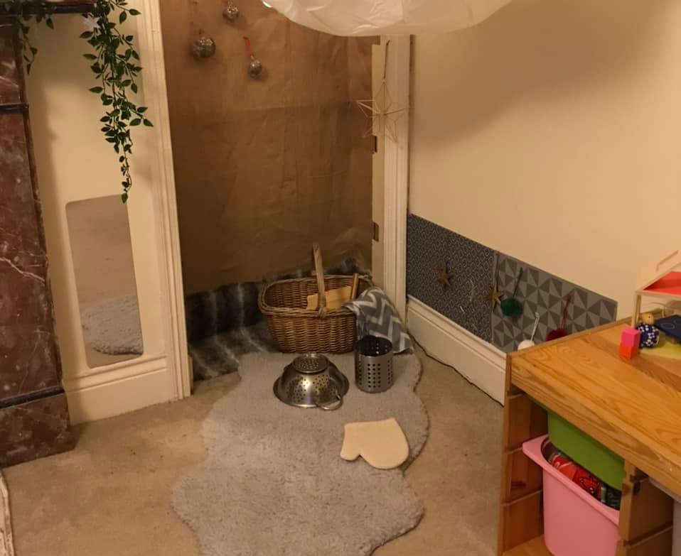
Rain Clouds - 0-1 year olds
Our baby room is a calm and relaxing area where babies can grow and develop at their own pace.
The resources in this area are all floor based allowing access for little crawling babies and quiet areas for children to spend tummy time together with their key worker.
Our calm and soothing baby room is an extension of home as we follow individual routines that you follow at home.
The room is decorated in neutral colors and gives lots of sensory opportunities for little ones to explore their senses!
Natural resources and sensory baskets allow young babies to investigate their natural environment and helps develop those first skills they need as they grow.
The ratio in this room is 1:3, this means that one member of staff for every 3 children in the room.
Our Rooms…..

Slide 6
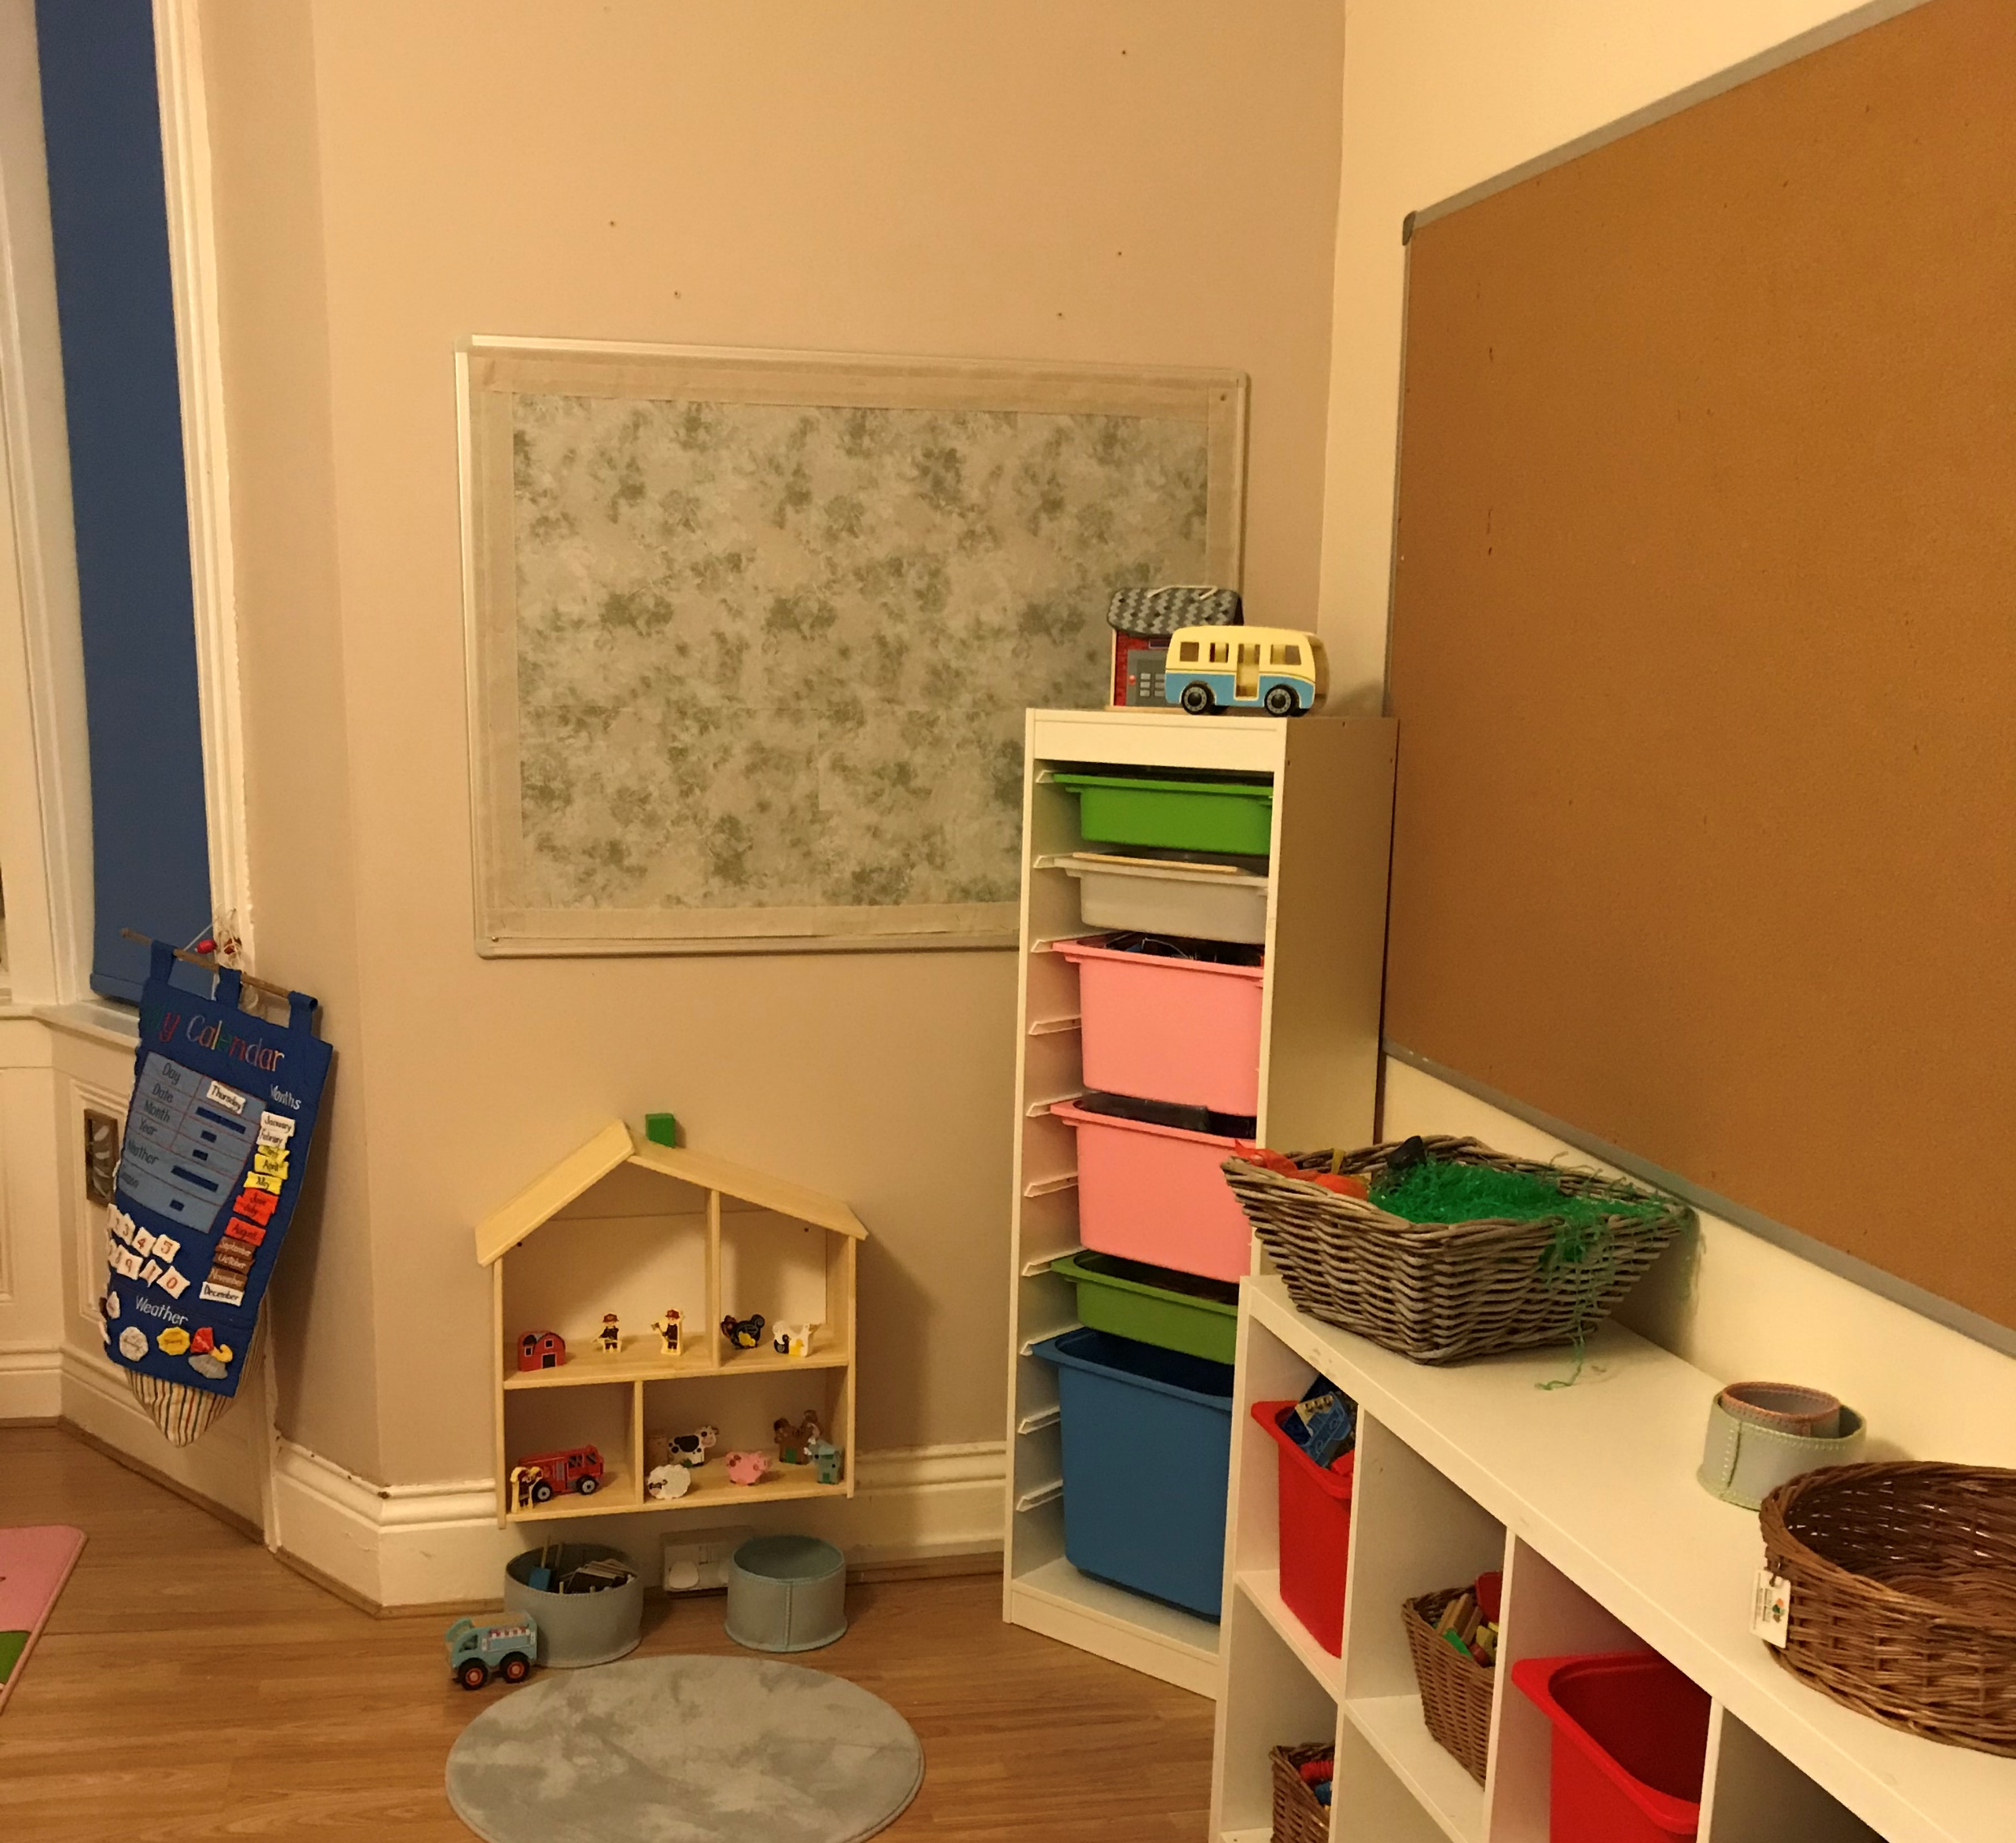
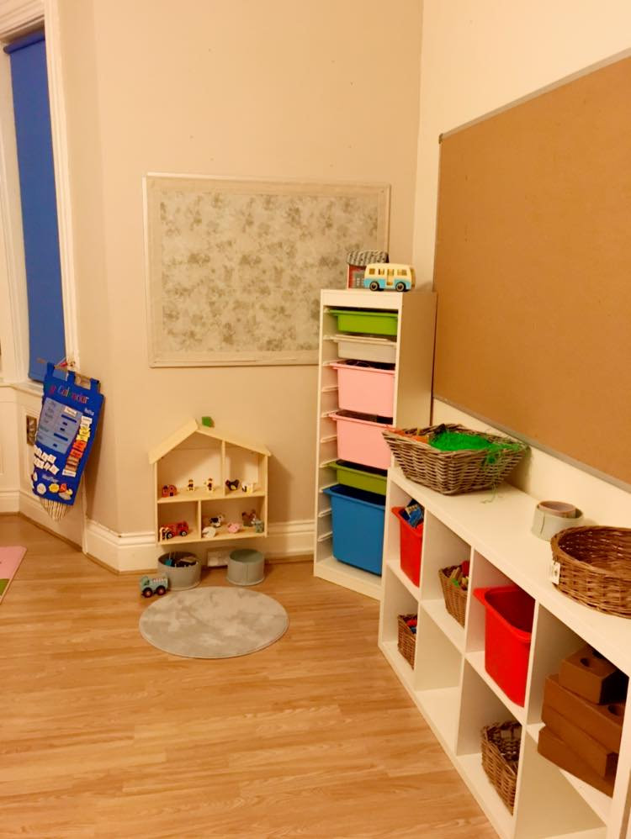
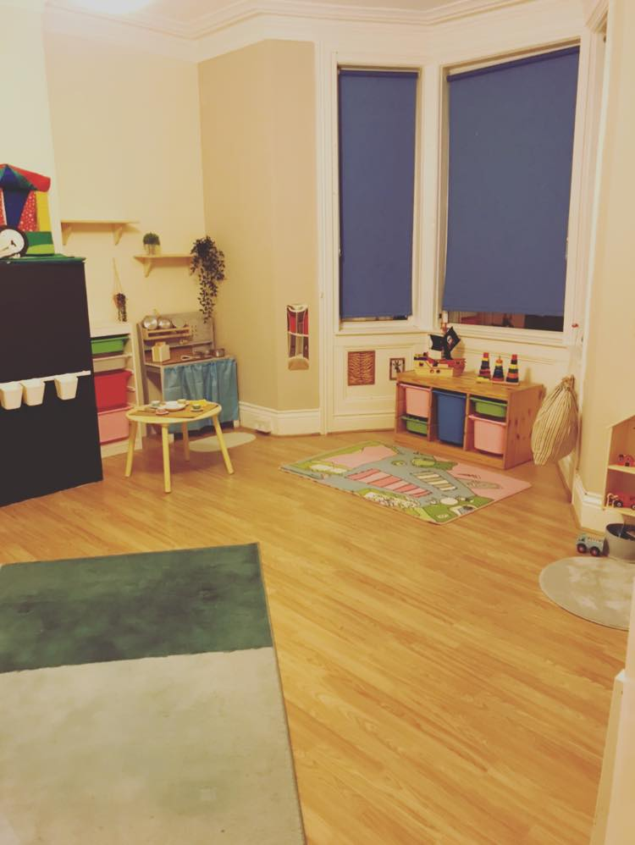
Sunshines2-3 years
Our Toddler room is a warm and homely environment where the children have opportunity investigate and explore through play.
We have resources that are available for the children to access freely and areas that provide learning opportunities.
The Large mark making area lets the children explore using various materials and develop those skills needed to become school ready. The children learn through play and this area lets each child play based on their own interests and at their own pace.
Children need some quiet time to think and relax and our quiet area allows children to have some time out from playing and can access a range of resources to read and think about.
The ratio in this room is 1:4 this means for every 4 children in the room there is 1 member of staff.

Slide 7
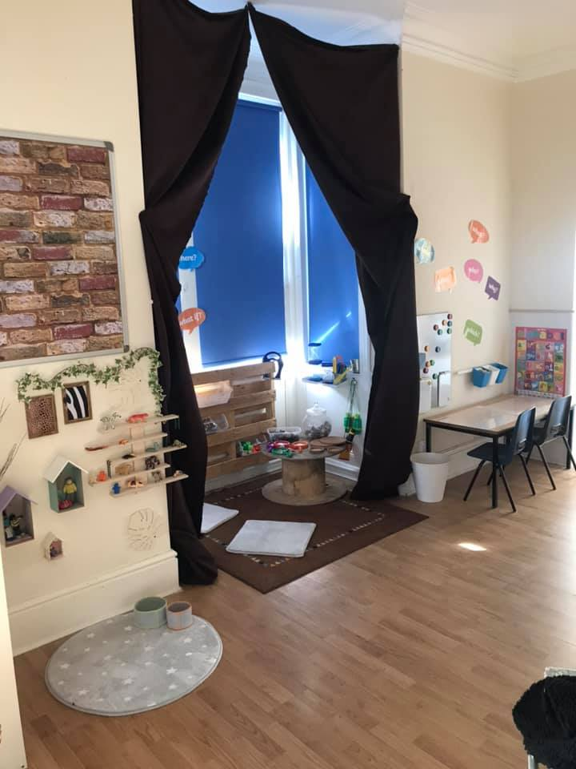
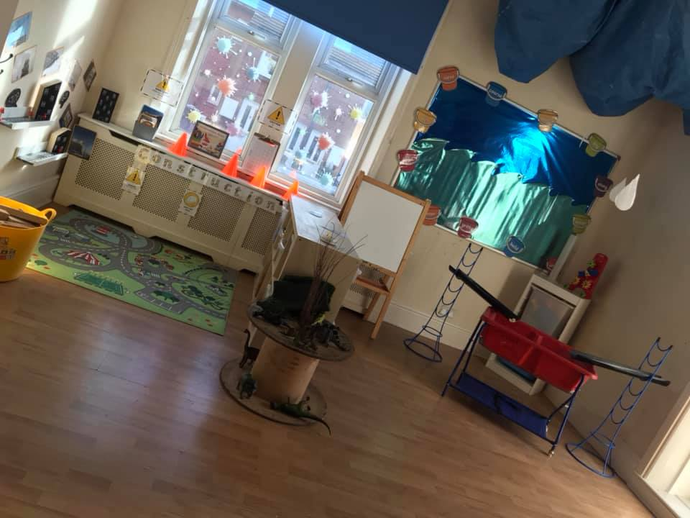
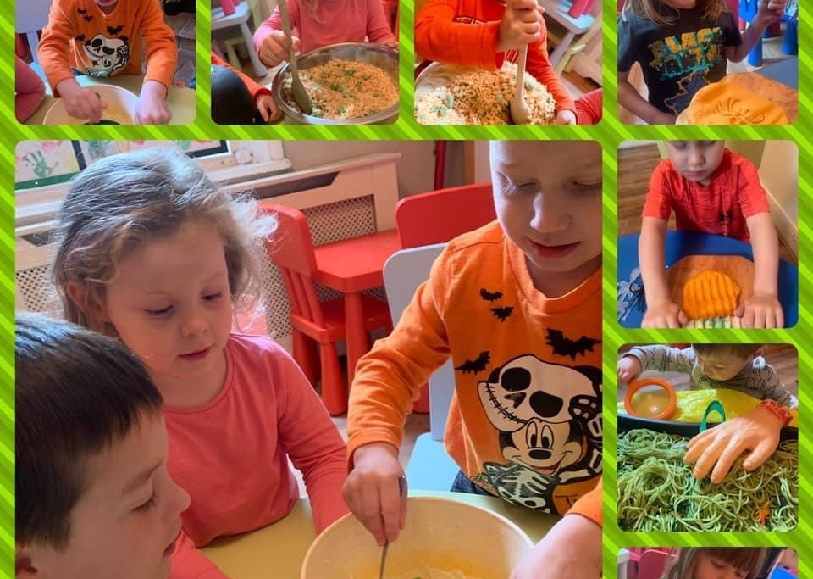
Rainbows-3-5 years
Our pre-school room is a large open area for our young children to play and learn. The room has lots of areas to explore and investigate and lets children access resources freely.
This room is free flow between the indoors and out which allows children the opportunity to play and learn about the world they live in.
Children start to become school ready at this age and staff work with them to develop their skills and understanding.
Children have access to open ended resources, and we explore their curiosity using ordinary household items in all areas.
Ration in this room is 1:8, this means there is 1 member of staff for 8 children.

Slide 8
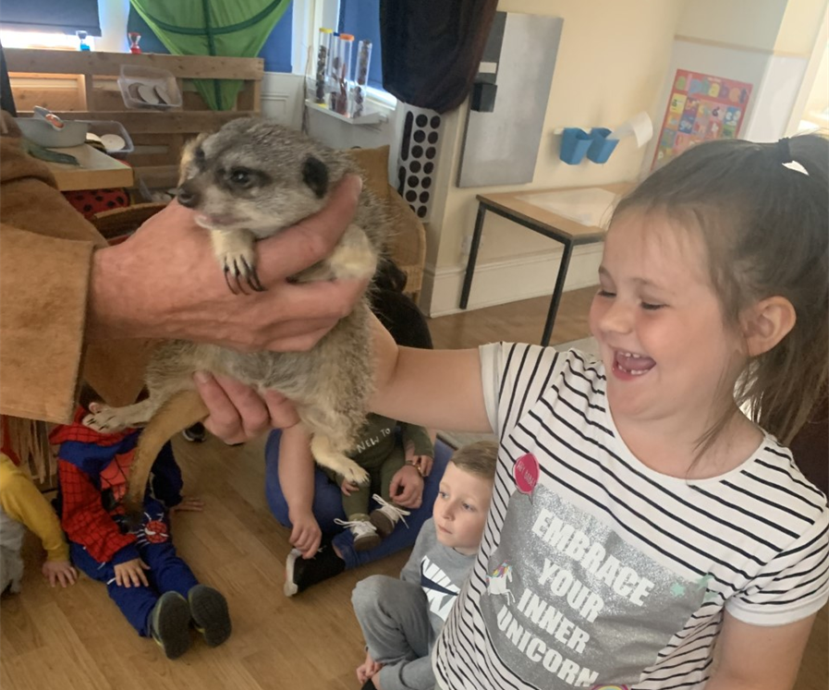

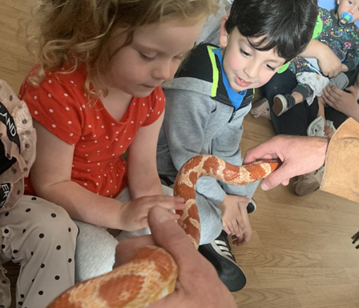
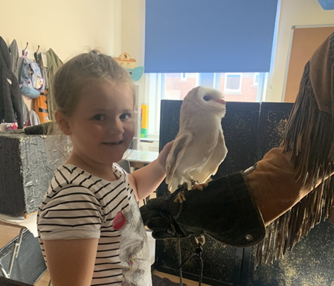
We provide a drop and pick up service from local schools in the areas. We currently collect from the following schools:
Denbigh
St Peters
Stephenson Memorial
Hadrian Park
Western
We have a set rate for pick ups and drop offs and these prices include all meals and snacks.
Drop off- £5.00
Pick up-£10.00
We also provide wrap around care children using their funded hours. We don’t charge any extra fees on top of this funding rate and any additional hours outside of the funding is charged at our hourly rate of £4.00.
We run Holiday clubs throughout the year, and this is a set rate of £25.00 per child. Our times are 9am-4pm but we are flexible with hours and can work around your needs.
During holiday club we provide all meals and snacks, and we don’t charge additional fees for any activities that we provide or trips that are arranged.

Slide 9
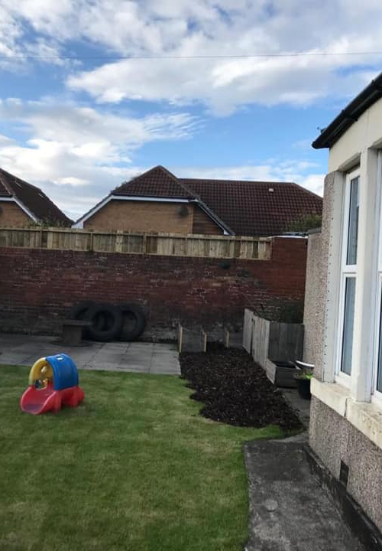
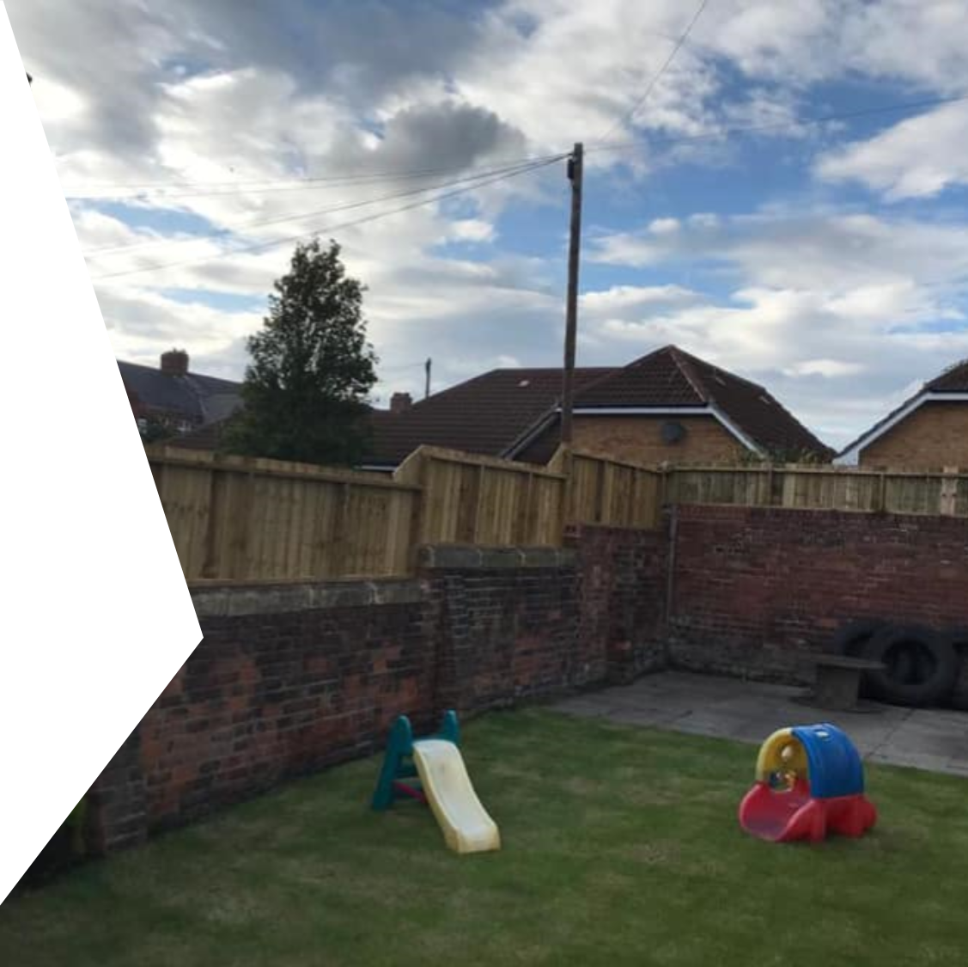
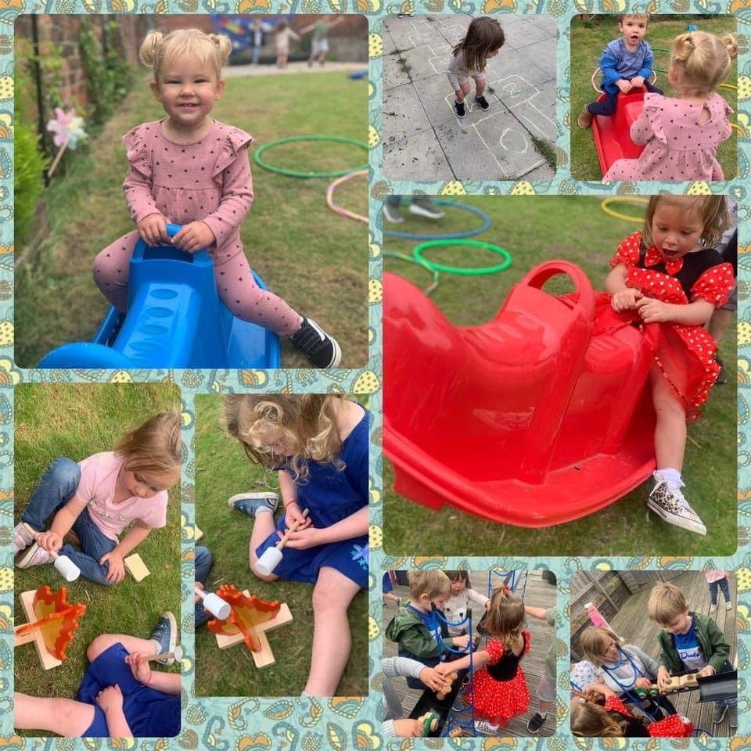
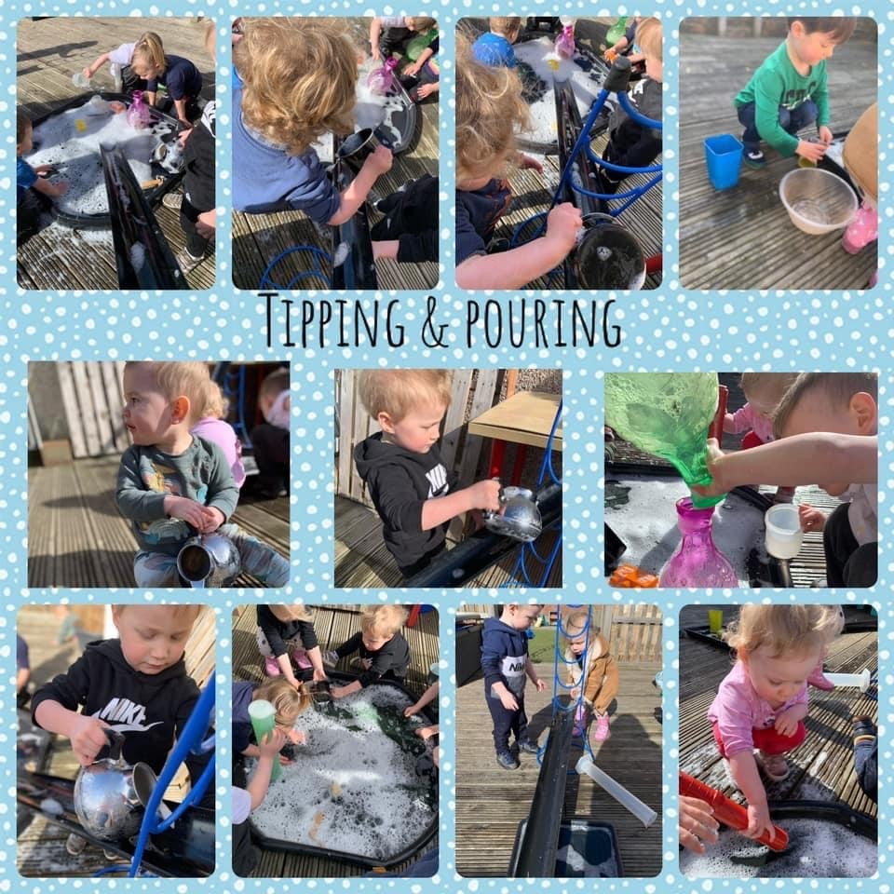
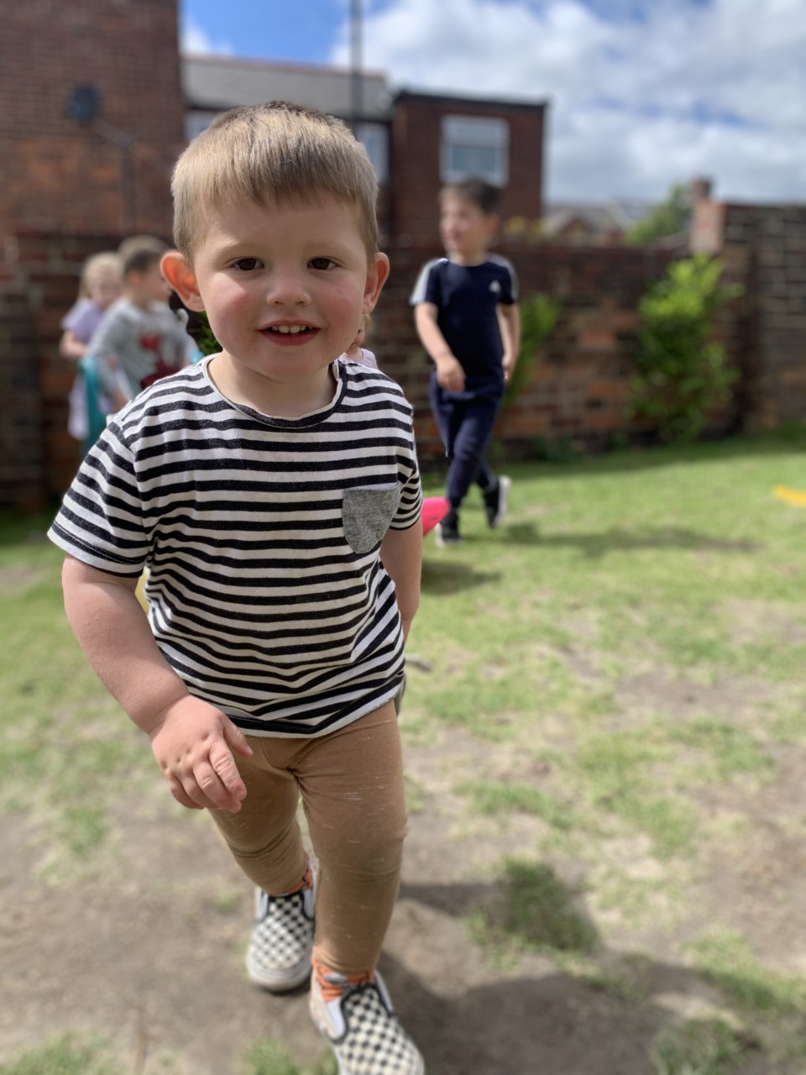
Our Garden
Our nursery garden is a large area that the children can explore and investigate freely. We have various areas for the children to play and explore in, grassy areas for bug hunts and crawling babies, decking with a large role playhouse for the children to use their imaginations and a paving area that the children can use their gross motor skills to jump, run and climb on our tires and climbing equipment.
We have free flow to the garden and staff plan and provide fun WOW moments that give fantastic learning opportunities to the children.

Slide 10

We understand how difficult it is for parents to leave their child and return to work. We will therefore work with you to ensure your child is settled and that you are happy with the care that we provide.
We will organize settling in sessions for the parents and child. This gives you the opportunity to provide us with lots of information about your child, their likes and dislikes, routines, favorite activities, how to comfort them if they become upset and how they have reacted when left before. It gives us the opportunity to start to build a relationship with you and your child and to understand both your needs and wishes.
We are happy for you to stay until you feel that your child is settled. Some children do take longer than others to settle and some settle quickly and then become distressed a few weeks into the placement. we will work with you to support your child through this transition period and make it as easy as possible. It is important that you and your child are relaxed and happy in the setting and with the care provided.
Some parents find it helpful to call us during the day to find out how their child is. We are happy to take your calls, but sometimes we are not able to talk for long, or even to answer the telephone if we are attending to a child’s personal needs, for example changing a nappy. So please do not panic if you call and there is no answer.
There is no charge for settling in sessions and the number of sessions is based on each individual child and their parents /carers.

Slide 11
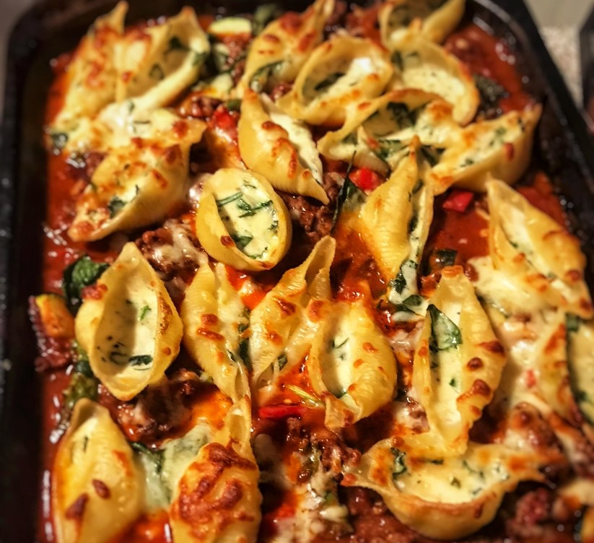


Food…
All the food and snacks provided at nursery are home made using fresh and healthy fruit and vegetables sourced from local suppliers.
At mealtimes we all come together and eat in the dining room. The children are encouraged to help set up tables and serve their own food where possible.
We cater for all cultural and religious needs and have vigorous plans in place for any allergies that children may have. All our menus can be adapted to suit, and this can be discussed with staff at any time.

Slide 12
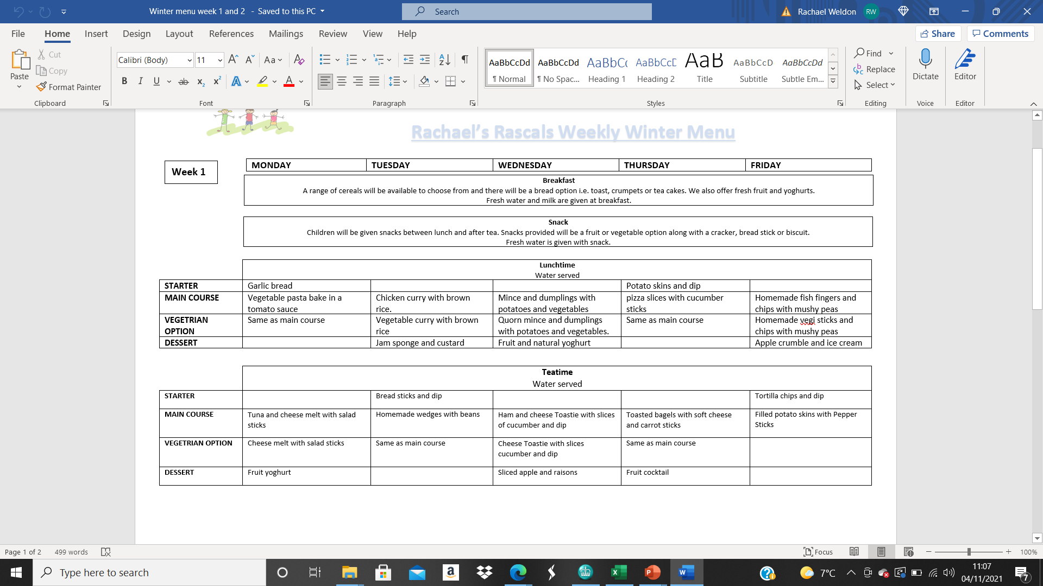
Menu Example

Slide 13
Our nursery provides flexible childcare at affordable rates.
Nursery Fees-
At Rachael’s Rascals we charge an hourly rate for our childcare services.
Our fees all include-
• Nappies and wipes
• Breakfast
• Morning and afternoon snacks
• Lunch
• Tea
• Fresh water available throughout day and at meals
Age of child | Rates | Opening times | Closing times
0-3years | £5.50 per hour | 7.30am | 6.30pm
3-4 years | £5.00 | 7.30am | 6.30pm
Funding-
We offer places for funding and have no hidden fees!
We can offer funding spread across the week or month so you can use the hours to fit around the days you need.
Funding | Hours
2 years funding | 15 hours
3 years funding | 15 hours
3 years funding (working parents) | 30 hours
Payments-
We offer various options for fees to paid. We take the following payment schemes-
• Funded hours
• Tax free voucher schemes
• Government top up scheme

